Slide 1
Otis W. Brawley, MD, FACP, FASCO Chief Medical and Scientific Officer American Cancer Society Professor of Hematology, Medical Oncology, Medicine and Epidemiology Emory University

Slide 2
Figure 1
1900-1970, US Public Health Service, Vital Statistics of the US, Vol. 1 and Vol 2; 1971-2010, US National Center for Health Statistics, Vital Statistics of the U.S
Age Adjusted to year 2000 Standard

Slide 3
NCI SEER 2012

Slide 4
Figure 4A
NCI SEER 2010
Age Adjusted to year 2000 Standard

Slide 5
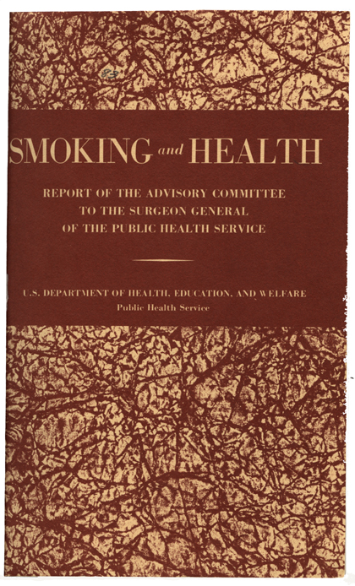
Copyright 1964, U.S. Department of Health, Education, and Welfare

Slide 6
U.S. Smoking Prevalence by Gender 1955-2010
Figure 4B
Percent

Slide 7
Cigarette Smoking 1964
A part of American culture (more than 52% of men and 35% of women smoked)
The US grew and exported more tobacco than any other country
$15 Billion in wages and 660,000 American workers

Slide 8
Lung Cancer
Rare in 19th Century
Increasing rate of diagnosis in early to mid 20th century
Suspected reasons for the increase?
Industrial pollution
Street pavement products
Chemicals used in WWI

Slide 9
Case Control Studies
Fritz Lickent – Dresden 1929
Franz Herman Muller – Cologne 1939
Alton Oschner and Michael Debakey – New Orleans 1941

Slide 10
Large Case Control Studies
Ernst Wynder and Evarts Graham – 1950
605 males with lung cancer compared to age matched controls.
Lung cancer patients more likely to smoke.
Sir Richard Doll and Sir Bradford Hill – 1950
1357 lung cancer patients age and gender matched to controls.
Lung cancer patients more likely to smoke.

Slide 11
Prospective Cohort Studies (following participants over time)
Doll and Hill - 40,637 British Physicians
Result published 1954
Hammond and Horn – 204,547 Men
Result published 1954 and 1958

Slide 12
Declarations that Tobacco Use Harmful 1955-1959
British Medical Research Council
American heart Association
Joint Tuberculosis Council of Great Britain
Canadian National Department of Health and Welfare
Cancer Societies of Denmark, Norway, Sweden, Finland, the Netherlands and
The American Cancer Society

Slide 13
Surgeon Generals Report of 1964
Led to:
Cigarette Labeling and Advertising Act of 1965 mandated warnings on cigarette packages and advertising.
Federal Trade Commission mandated broadcast stations give free broadcast time for antismoking public service announcements.
In 1970, the tobacco industry voluntarily withdrew radio and television ads in order to eliminate free broadcast time.

Slide 14
Environmental Tobacco Smoke
Second hand or passive smoke linked to:
Lung cancer
Bronchitis
Asthma
Cardiovascular disease
Crib death

Slide 15
Environmental Tobacco Smoke
Proof of harm to non-smokers galvanized the anti-smoking movement
Smoking stopped being part of the social norm.
It became unacceptable to smoke in public.

Slide 16
Environmental Tobacco Smoke
Pressure on state and local governments to ban smoking in:
Public buildings,
Public transportation,
Workplaces,
Restaurants,
Shopping malls,
Theaters,
Schools

Slide 17
The American Tobacco Industry
Questioning the science showing harm
Work to weaken package warning labels
Support smoker’s rights campaigns (free choice)
Support anti-tax efforts

Slide 18
Master Settlement Agreement (November 1998)
Agreement between most major tobacco manufactures and 46 states.
$206 billion to states over 25 years to reimburse for healthcare costs.
Limited industry promotion and advertising practices.
$5.5 billion over ten years in aid to tobacco farmers to encourage them to grow other crops.

Slide 19
The Family Smoking Prevention and Tobacco Control Act of 2009
The US Food and Drug Administration (FDA) has authority to regulate the manufacture, marketing, and sale of tobacco products.
The industry must disclose all ingredients to the FDA.
Fruit and candy flavorings are now banned.

Slide 20
The Family Smoking Prevention and Tobacco Control Act of 2009
Tobacco cannot be advertised as light, low tar, or mild.
Tobacco companies cannot sponsor sports or entertainment events.
Companies cannot give away free tobacco or sell cigarettes in packs of less than 20.

Slide 21
The Importance of Preventing Adolescents from Smoking
Nicotine is more addictive than cocaine.
Cessation rates among moderate to heavy smokers are low.
Most smokers start in their teen (adolescent) years.
In 2011, 18.1% of high school students report smoking at least one day in the past 30. 6.4% are daily smokers.

Slide 22
Smoking Prevalence by Race 2003
 | Female | Male
NH White | 18.1% | 21.5%
Black | 15.4% | 21.8%
Native American | 30.0% | 33.7%
Asian Pacific Islanders | 5.1% | 17%
Hispanic | 9.1% | 16.1%
CDC, MMWR 2009

Slide 23
Smoking Prevalence 2010
Males - 21.6%
Females - 16.5%
Native Americans - 31.5%
Below Poverty Level - 29.1%
CDC, MMWR 2012

Slide 24
U.S. Smoking Prevalence by Gender 1955-2010
Figure 4B
Percent

Slide 25
Results
From 2000 to 2007, cigarettes sales declined by 18 percent.
Offset by increases in sale of cigars, cigarillos, and moist snuff.
In 2010, 10.4% of adult men and 3.1% of adult women smoked cigars or cigarillos.
E-cigarettes are becoming an issue.

Slide 26
Comprehensive Tobacco Control (make smoking inconvenient)
Economic regulatory policy
Public education
Changing of social norms
Clinical Cessation strategies

Slide 27
Otis W. Brawley, MD, FACP, FASCO Chief Medical and Scientific Officer American Cancer Society Professor of Hematology, Medical Oncology, Medicine and Epidemiology Emory University

